Slide 1
Collision - NYC
Crash collision data – Y2022

Slide 2
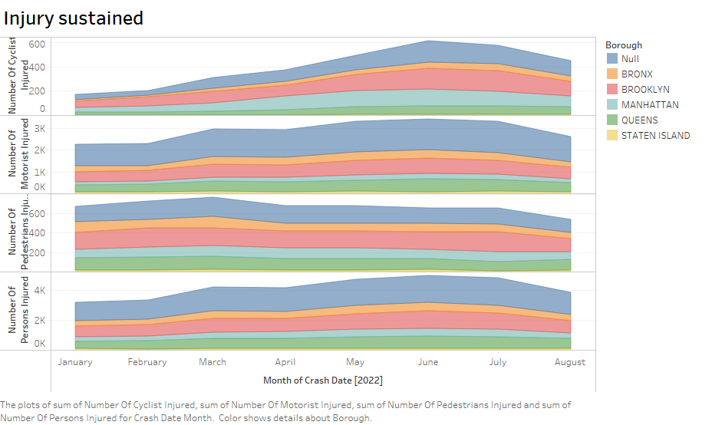

Slide 3
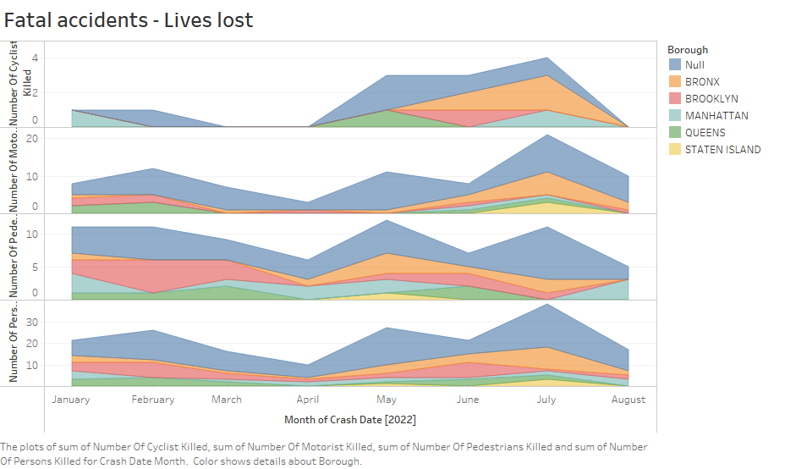

Slide 4
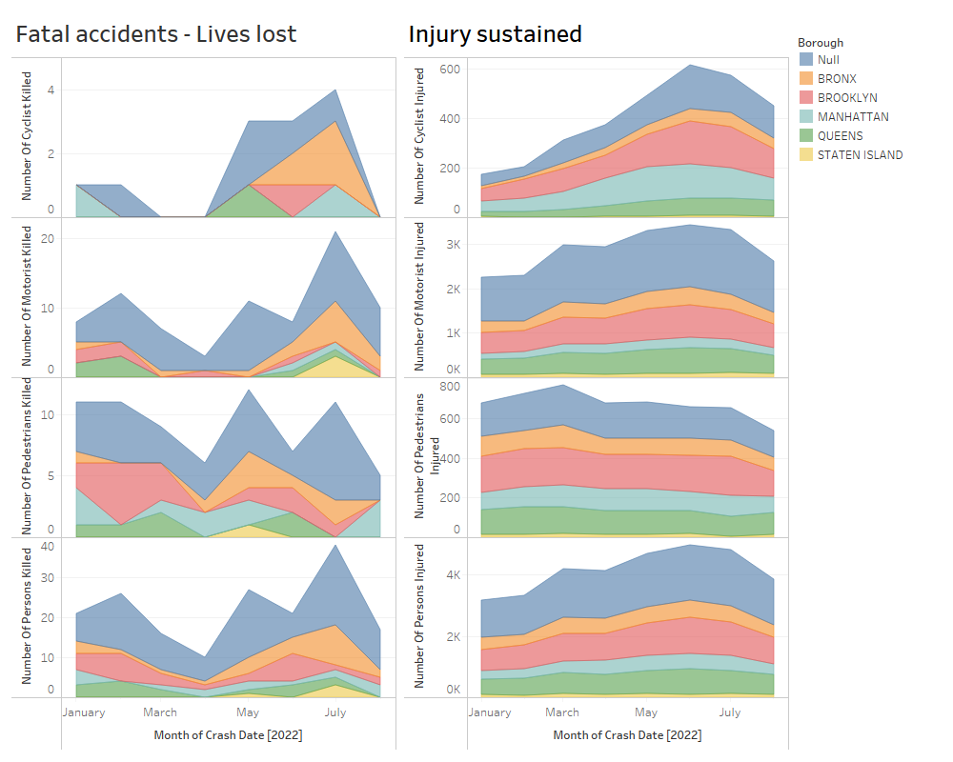

Slide 5
